Slide 1

Citi-Bike Ride Sharing Analytics
Erica Yang BUS 446

Slide 2
Analysis 1
Purpose:
To explore the correlation between the preferred days of the week for bike rides between members vs casual riders.
Why is this useful?
Notes:
Question 1
Is there a correlation between the preferred days of the week for bike rides between members vs. casual riders?
There are patterns in bike usage that can be based on geography and location. Bike usage might only be for those commuting to and from work on weekdays vs a spike in bike activity during weekends when people go out for a longer period of time. Understanding these patterns can be valuable in business situations for roles related to urban planning, transportation management, or even for businesses directly involved in the bike-sharing industry.
EX: If the business desires to convert the casual riders to upgrade to members and wants to know the best days for heavy advertisement or recruitment.

Slide 3
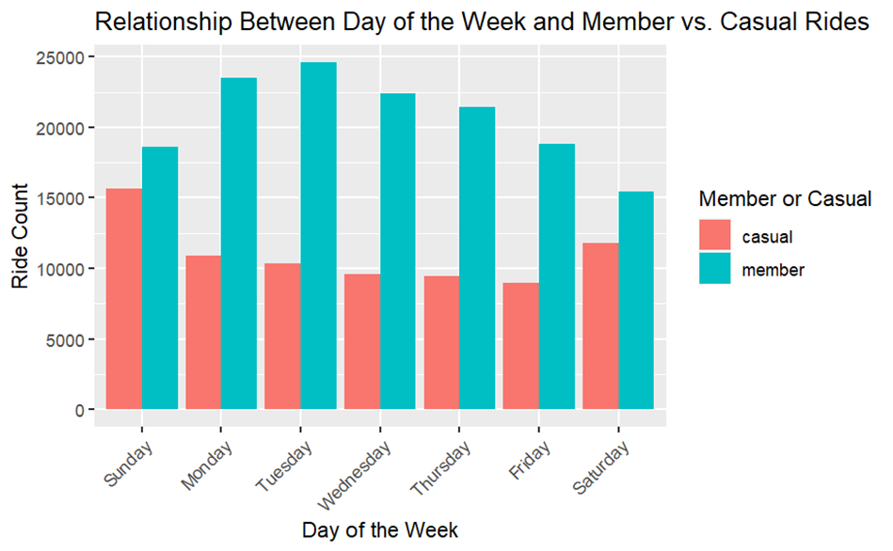
Notes:
Based on the graph details, Sunday and Saturday have the most active casual riders. Therefore, if the business desires to convert the casual riders to upgrade to members, then it would make sense to advertise heavier on those days’ vs the other days.

Slide 4
Types of Business Utilization
Urban Planners
Transportation Companies
Marketing and Sales
Data Analysts and Researchers
Tourism Industry
Notes:
Urban Planners: Knowing when and where people tend to use bikes can inform the development of bike lanes, parking facilities, or even the placement of bike-sharing stations.
Transportation Companies: Businesses offering bike-sharing services can optimize their operations by deploying more bikes or adjusting pricing based on peak usage times and popular locations.
Marketing and Sales: Retailers selling bikes or bike-related accessories can tailor their marketing campaigns, discounts, or promotions to align with the days where bike usage is highest.
Data Analysts and Researchers: Professionals in these roles can use this information to conduct deeper analysis, identify trends, and make predictions about future bike usage patterns.
Tourism Industry: In tourist-heavy areas, understanding bike usage patterns can help tour companies plan routes and schedules for bike tours more effectively.

Slide 5
Analysis 2
Purpose:
To study bike usage patterns across locations at different times aims to reveal geographic influences on daily bicycle utilization.
Why is this useful?
Notes:
Question 2
Are there specific patterns in the usage of bikes based on their geography during different times of the day?
Understanding this can guide bike-sharing companies to strategically allocate more resources, such as deploying additional bikes or staffing, during these peak hours to meet heightened demand. It also allows for targeted marketing efforts, directing promotional campaigns toward these specific time frames to attract more users and maximize business potential.

Slide 6
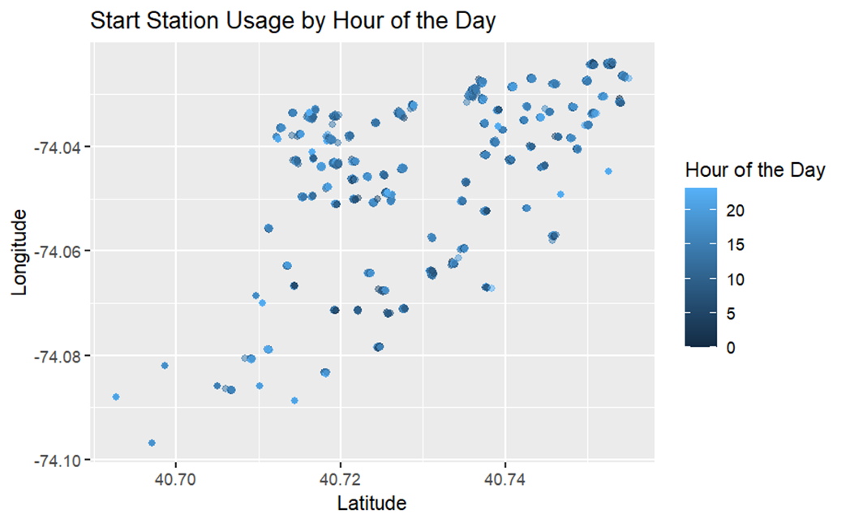
Notes:
The considerable increase in starting riders between 12 PM and 12 AM, compared to the period from 12 AM to 12 PM, presents an opportunity for businesses to optimize services based on these usage trends.

Slide 7
Types of Business Utilization
Data Analysts
Market Researchers
Business Development Managers
Entrepreneurs in the Transportation Sector
Notes:
Data Analysts: Analyzing bike usage patterns can help these professionals identify trends, peak hours, and popular routes. This information can be used to optimize bike-sharing services, plan maintenance schedules, or forecast demand for bikes and accessories.
Market Researchers: They can utilize this data to understand consumer behavior related to biking, informing marketing strategies for bike-related products or services. Insights into when and where people use bikes most frequently can guide targeted advertising campaigns.
Business Development Managers: Understanding bike usage patterns can help in forming partnerships or collaborations, such as working with local businesses to provide bike-related services or integrating biking facilities with other transportation modes.
Entrepreneurs in the Transportation Sector: Entrepreneurs looking to start bike-sharing or bike rental businesses can use this data to identify underserved areas or peak times for potential expansion and marketing efforts.

Slide 8
Analysis 3
Purpose:
To investigate if members and casual riders differ in ride durations based on the day and starting station.
Why is this useful?
Notes:
Question 3
Do members and casual riders tend to take longer, or shorter rides based on the day of the week and the starting station?
Understanding whether members and casual riders take longer, or shorter rides based on the day of the week and starting station can provide insights into user behavior and preferences.

Slide 9
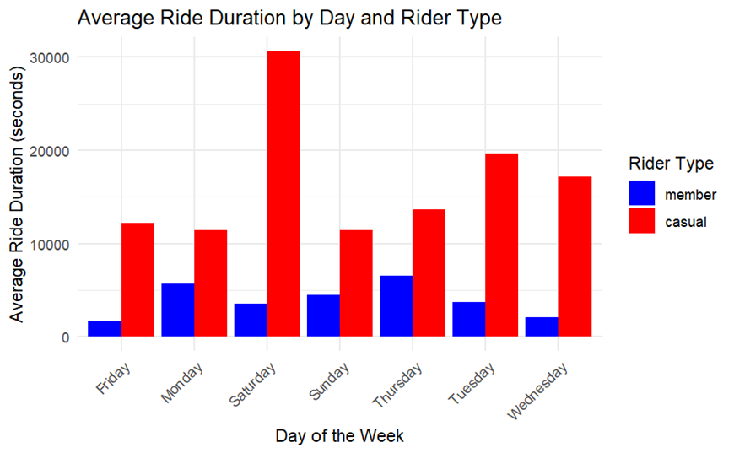
Notes:
In general, casual riders seem to have longer ride duration than members on all days of the week.

Slide 10
Types of Business Utilization
Bike Share Operations Managers
Marketing and Sales Teams
Product Development Teams
Data Analysts and Researchers
Customer Experience and Support Teams
Notes:
Bike Share Operations Managers: Knowing the ride duration based on the day of the week and starting station can help in optimizing bike distribution. If certain stations see longer rides on weekends, they might need more bikes available during those times to meet demand.
Marketing and Sales Teams: Understanding the differences in ride durations can help in targeted marketing campaigns. If casual riders tend to take longer rides on specific days or from starting stations, marketing efforts can be tailored to attract more casual riders during those times or locations.
Product Development Teams: Insights into ride durations can inform the development of subscription plans or pricing structures. If members tend to take consistently shorter rides on weekdays from specific stations, there could be opportunities to offer targeted subscription packages incentivizing shorter rides for regular commuters.
Data Analysts and Researchers: Professionals in these roles can delve deeper into this data to identify patterns and correlations that might not be immediately evident. This can lead to more nuanced insights, helping businesses make data-driven decisions in various aspects of operations and strategy.
Customer Experience and Support Teams: Understanding user behavior regarding ride durations can also help in improving user experiences. For instance, if there are stations or days where riders tend to face issues or longer wait times due to high demand, customer support strategies can be adapted accordingly.

